Slide 1
CS 2212
Introduction to Software Engineering
Chapter 8 Requirements Modeling

Slide 2
Copyright Notice This Presentation and Its Associated Video Contain Copyright Material. This Presentation and Its Associated Video Are Provided for Teaching Purposes of CS2212 and Should Not Be Posted In Any External Site, Or Shared with. This Presentation and Its Associated Video Are Provided For Instructional Personal Use Only, and Only For The Purposes of the CS2212 Course.

Slide 3
Part 21
UML Sequence Diagrams
No one in the brief history of computing has ever written a piece of perfect software. It's unlikely that you'll be the first.
- Andy Hunt
Notes:
This lesson introduces the basic steps in a software engineering project at a high level.
In practice, steps often overlap.

Slide 4
Learning Objectives in this Part
To understand the concept of specifying the interactions of entities in Use Cases using Sequence Diagrams
To understand the notation and semantics of Sequence Diagrams
To delve into examples of Sequence Diagrams

Slide 5
Part 21-a
UML Sequence Diagrams - Notation
Notes:
This lesson introduces the basic steps in a software engineering project at a high level.
In practice, steps often overlap.

Slide 6
Sequence Diagrams
A sequence diagram indicates how events cause transitions from object to object in a software system over time
In a way, a sequence diagram is a shorthand version of the use case it is derived from, representing key classes and the events that cause behavior to flow from class to class
Time is measured vertically (downward) and narrow vertical rectangles represent activation time spent in processing an activity
States may be shown along a vertical time line
A UML diagram type similar to Sequence Diagram is the Collaboration Diagram

Slide 7
Examples of Interaction Diagrams
x
y
z
1.1: a 1.2: c
a
x
y
b
1.1.1: b
c
z
Sequence Diagram
Communication Diagram
(or Collaboration Diagram)

Slide 8
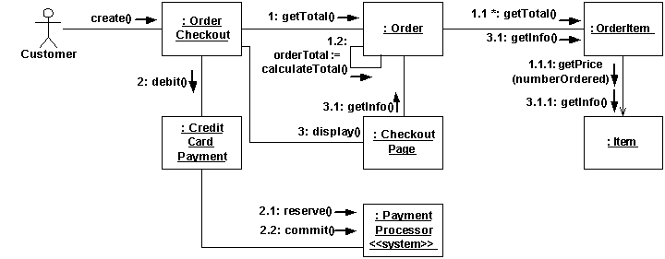
Example Communication Diagram

Slide 9
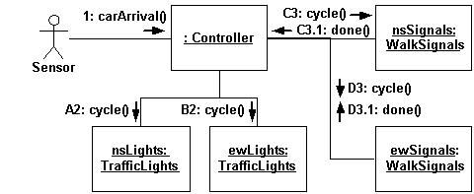
Example Communication Diagram with Concurrent Flows
Flows A2, and B2 are concurrent. Also, flows C3, and D3 are concurrent. The
ame holds for flows C3.1 and D3.1

Slide 10
Sequence Diagrams
Sequence diagrams can also contain:
Both synchronous and asynchronous messages
Creation and deletion of objects
Loops, including objects sending themselves messages
Once a complete sequence diagram has been developed, all of the events that cause transitions between system objects can be collated into a set of input events and output events
This information is useful in the creation of an effective design for the system to be built

Slide 11
Structural Elements of Interaction Diagrams (1)
Construct
Description
Syntax
Implementaion - Case (object, data, component, process etc.)
Denotes an object as a unique entity. This object can receive and send messages, and can have a state at a given point of time
name
attr values
Action
Speifies en executable command. Some commands are predefined in UML e.g. Create, Call, Destroy, and Uninterpreted.
Text

Slide 12
Structural Elements of Interaction Diagrams (2)
Construct
Description
Syntax
Message
Denote the communication betwen two implementations
Operation
Defines a service which can be requested from an entity (implementation) and relates to the scenario being specified
Κείμενο
(textual)
Message
Specification
Specifies the details of an asynchonous message between two implementations
«Signal» Name
parameters

Slide 13
Structural Elements of Interaction Diagrams (3)
Construct
Description
Syntax
Link
Denotes a link or association between two entities (i.e. implementations)
Variable
Denotes the name of a variable that can take a values as an attribute of an entity (i.e. implementation).
Text

Slide 14
Structure of a Sequence Diagram
object symbol
name : Class
other
lifeline
message (stimulus)
name.op (…)
activation
new (…)
: Class
Delete
(termination)
return
κατασκευή
(create)

Slide 15
Message Types
Denotes Synchronous Communication (SendRequest-block-GetResponse-Continue)
Denotes the return of a call (message)
Denotes Asynchronous Communication (SendRequest-DoOtherWorkInBetwen-GetResponse-Continue)

Slide 16
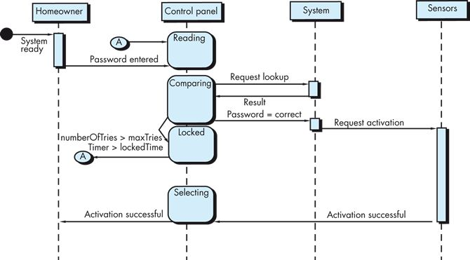
Example Sequence Diagram
Sequence diagram for the
SafeHome security function

Slide 17
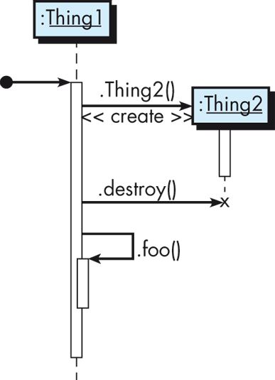
Example Sequence Diagram
Sample sequence diagram showing the creation and deletion of objects, as well as loops

Slide 18
More Examples
Nested Flow
Nested Flow
Asynchronous Flow
teller
: Order
: Article
teller
: Order
: Article
caller
exchange
callee
lift receiver
getValue
getValue
dial tone
price
price
dial digit
dial digit
getName
getName
ringing tone
ringing signal
lift receiver

Slide 19
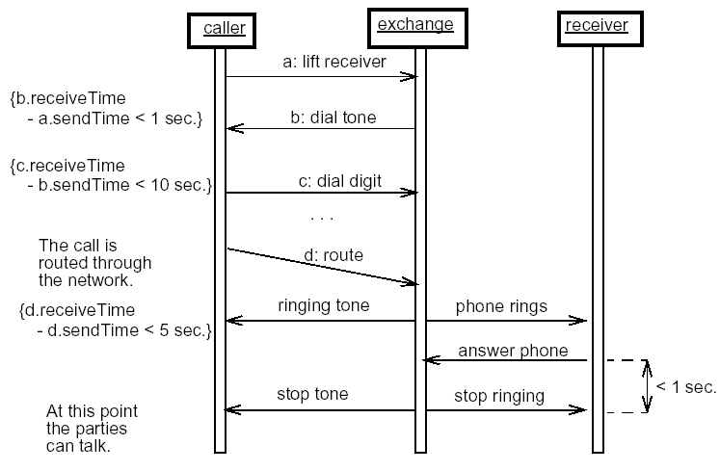
Sequence Diagram with Multiple Active Objects

Slide 20
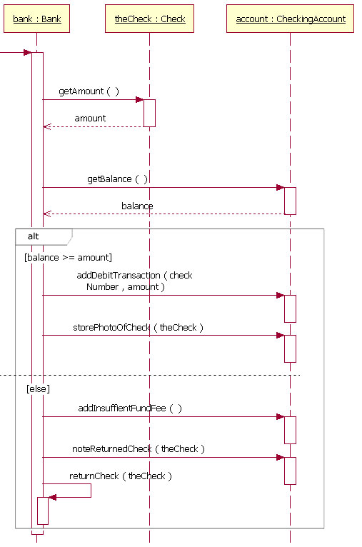
Alternative Flow
https://developer.ibm.com/articles/the-sequence-diagram/

Slide 21
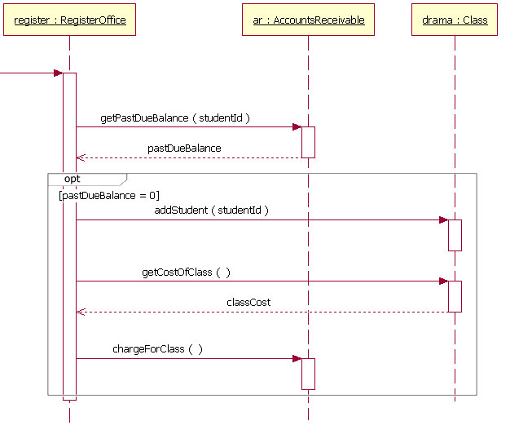
Optional Flow
https://developer.ibm.com/articles/the-sequence-diagram/

Slide 22
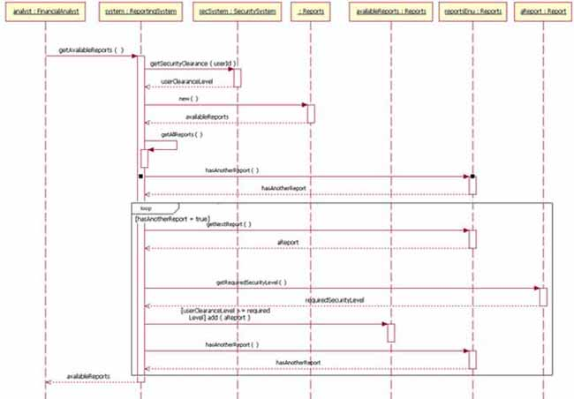
Iterative Flow
https://developer.ibm.com/articles/the-sequence-diagram/

Slide 23
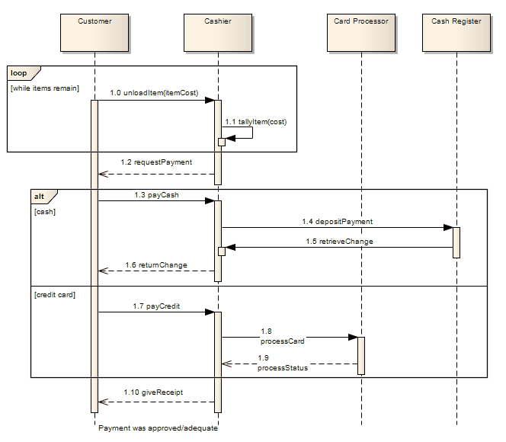
Iterative and Alternative Flow
https://sparxsystems.com/enterprise_architect_user_guide/15.1/model_domains/fragment.html

Slide 24
Part 21-B
UML Sequence Diagrams – Some Advanced Features
Notes:
This lesson introduces the basic steps in a software engineering project at a high level.
In practice, steps often overlap.

Slide 25
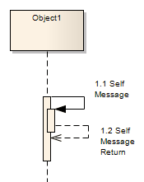
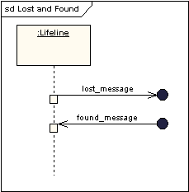
Messages and Self Messages
A self message can represent a recursive call of
an operation, or one method calling another method
belonging to the same object. It is shown as creating
a nested focus of control in the lifeline’s execution
occurrence [1].
Lost messages are those which go to a recipient not
shown on the current diagram [1], [2].
Found messages are those that arrive from a sender
not shown on the current sequence diagram [1], [2].
[1] https://sparxsystems.com/resources/tutorials/uml2/sequence-diagram.html
[2] https://www.ibm.com/support/knowledgecenter/SS8PJ7_9.7.0/com.ibm.xtools.sequence.doc/topics/cmsg_v.html

Slide 26
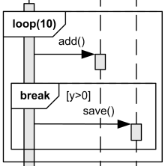
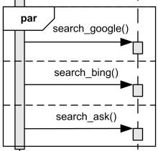
Break and Parallel Fragment
The interaction operator break represents a breaking or
exceptional scenario that is performed instead of the
remainder of the enclosing interaction fragment. A
break operator with a guard is chosen when the guard
is true. In this case the rest of the directly enclosing
loop interaction fragment is ignored [1].
The interaction operator par defines potentially parallel
execution of behaviors of the operands of the combined
fragment. Different operands can be interleaved in any
way as long as the ordering imposed by each operand
is preserved [1].
[1] https://www.uml-diagrams.org/sequence-diagrams-reference.html

Slide 27
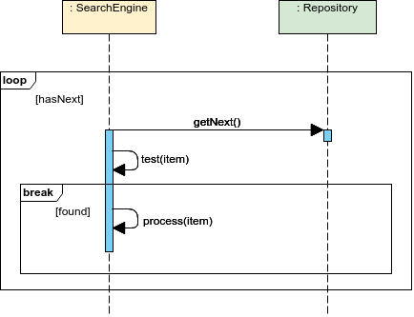
Iterative Flow with a Break Block
https://online.visual-paradigm.com/diagrams/templates/sequence-diagram/loop-fragment/

Slide 28
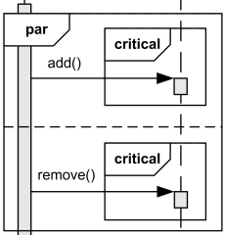
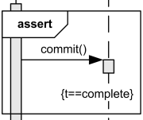
Critical Region and Assert
A critical region is a region with traces that cannot be
interleaved by other occurrence specifications (on the
lifelines covered by the region). This means that the
region is treated atomically by the enclosing fragment
and can't be interleaved, e.g. by parallel operator [1].
The interaction operator assert means that the combined
fragment represents the assertion that the sequences
of the assert operand are the only valid continuations
(must be satisfied by a correct design of the system).
All other continuations result in an invalid trace [1].
[1] https://www.uml-diagrams.org/sequence-diagrams-reference.html

Slide 29
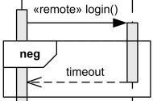
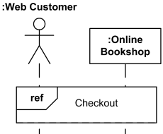
Negative and Interaction Use
The interaction operator neg describes combined
fragment of traces that are defined to be negative
(invalid). Negative traces are the traces which occur
when the system has failed [1].
The “Interaction use” is a fragment which denotes the use (or call) of another interaction named by the ref operator.
Large and complex sequence diagrams could be
simplified with interaction uses [1].
[1] https://www.uml-diagrams.org/sequence-diagrams-reference.html

Slide 30
Example: Change of Airline Ticket Reservation
Actors: traveler, airline data base, airline reservation system
Preconditions:
The traveler has already logged-in in the system and has selected the “change booking” option
Base use case route:
The system retrieves information related to bookings of the user from its data base
The system prompts the user to select a specific flight; The traveler selects a specific flight
The system prompts the traveler to select a new departure time/date; the traveler provides the required information
If the flight has seats available ...
…
The system confirms the changes provides a summary of the changes.
Alternative use case route:
If the flight does not have seats available then …

Slide 31
Sequence Diagram – Change of Airline Ticket Reservation
Traveler
: Booking System
Client Account DBMS
Client Account DBMS
Airline Reservation System
change flight itinerary
get customer account
get itinerary
present itinerary
select segment
present detailed info
update information
available flight
: :

Slide 32
Part 21-C
UML Sequence Diagrams - Examples
Notes:
This lesson introduces the basic steps in a software engineering project at a high level.
In practice, steps often overlap.

Slide 33
Example - 1 Sequence Diagrams
Examples adapted from http://elearning.uml.ac.at/

Slide 34
Example - 2 Sequence Diagrams
Examples adapted from http://elearning.uml.ac.at/

Slide 35
Example - 3 Sequence Diagrams
Examples adapted from http://elearning.uml.ac.at/

Slide 36
Example - 4 Sequence Diagrams
Examples adapted from http://elearning.uml.ac.at/

Slide 37
Example - 5 Sequence Diagrams
Examples adapted from http://elearning.uml.ac.at/

Slide 38
Example - 6 Sequence Diagrams
Examples adapted from http://elearning.uml.ac.at/

Slide 39
Behavioral Modeling in Summary
The general process is as follows:
Make a list of the different states of the software system (how does the system behave?)
Indicate how the system makes a transition from one state to another (how does the system change state?)
As part of this, indicate all events and actions that occur as a result
Draw a state diagram or a sequence diagram using this information

Slide 40
Your Turn
Revise the sequence diagram in slide 15 in order to use: a) an alt block in the point where the password is checked and; b) a loop block allowing three attempts to add a password before the system locks
What is the difference between a synchronous and an asynchronous message in sequence diagrams? Give one example of each and explain by giving and elaborating on the allowed sequences of messages in your diagram.
What is a critical block, and what is a parallel block? Give an example of combining them by giving and elaborating on the valid and some invalid sequences of messages in your diagram.
Check-out the content of the following sites:
https://www.tutorialspoint.com/uml/uml_use_case_diagram.htm
http://elearning.uml.ac.at/
http://www.math-cs.gordon.edu/courses/cs211/ATMExample/ (look at the sequence diagrams)
https://www.uml-diagrams.org/sequence-diagrams-reference.html

